Slide 1
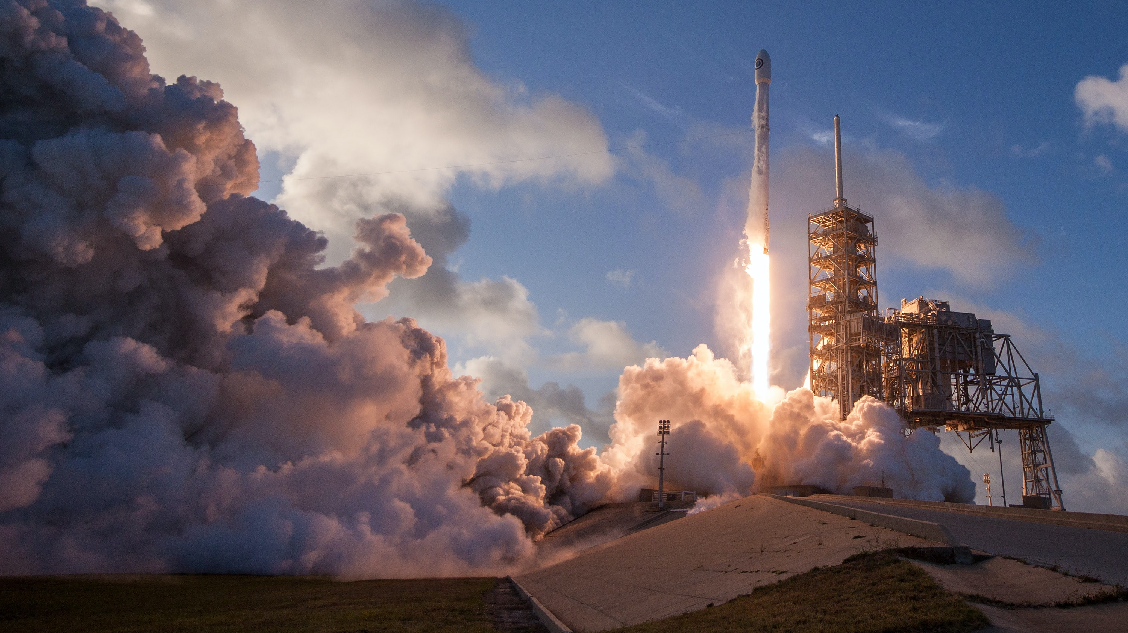
Winning Space Race with Data Science
Ghenu Malina-Nicoleta
28.10.2022

Slide 2

Outline
Executive Summary
Introduction
Methodology
Results
Conclusion
Appendix

Slide 3
Executive Summary
Methodologies used for Data Analysis
Data Collection using the SpaceX API and Webscraping & Data cleaning
Exploratory Data Analysis (EDA), data wrangling, data visualization & interactive visual analytics
Machine Learning Prediction
Summary of all results
Machine Learning Prediction
Collected data from public website
Identified which features are the best at predicting successful outcomes
By applying some basic statistical analysis and data visualization, I was able to see how variables are related to each other.
Tested various models to predict which one performs best on the dataset

Slide 4
Introduction
Our objective is to evaluate the viability of a new company, SpaceY, by analyzing existing company, SpaceX.
By gathering information about SpaceX launches and determining which factors lead to a successful landing of the first stage, we can predict the price of launch for company SpaceY.

Slide 5
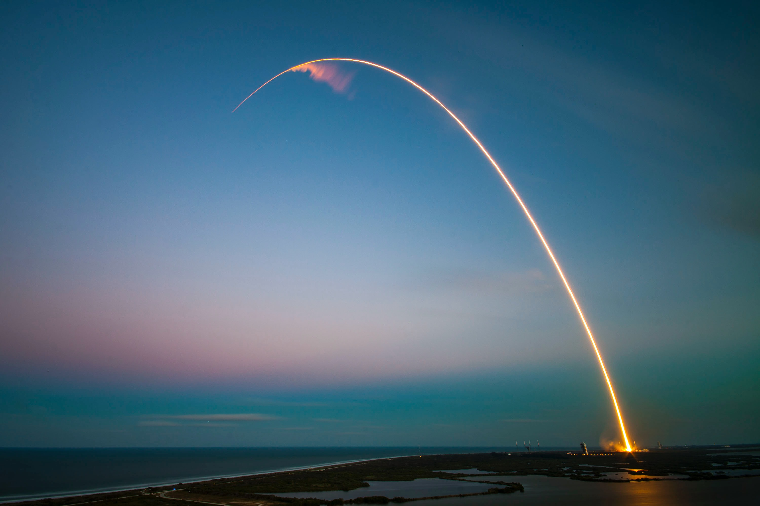
Methodology
Section 1

Slide 6
Methodology
Executive Summary
Data collection methodology:
SpaceX data was collected from two sources:
the SpaceX API (https://api.spacexdata.com/v4/rockets/)
the SpaceX Wikipedia page (https://en.wikipedia.org/wiki/List_of_Falcon\_9\_and_Falcon_Heavy_launches)
Perform data wrangling
The purpose of data wrangling was to find some patterns in the data and determine what would be the label for training supervised models and also convert the outcomes into Training Labels with '1' for successful landing and '0' for unsuccessful.

Slide 7
Methodology
Executive Summary
Perform exploratory data analysis (EDA) using visualization and SQL
Load the Spacex dataset
Sort and select the useful data for further analysis
Perform interactive visual analytics using Folium and Plotly Dash
By displaying the data in a useful way, we can see which variable is useful for our purpose
With interactive maps we can mark the successful/failed launches for each location
Perform predictive analysis using classification models
After standardizing the data and splitting it into train and test sets, we find the method that performs best on out test set

Slide 8
Data Collection
SpaceX data was collected from two sources:
The SpaceX API (https://api.spacexdata.com/v4/rockets/).
The SpaceX Wikipedia page (https://en.wikipedia.org/wiki/List_of_Falcon\_9\_and_Falcon_Heavy_launches)
After requesting rocket launch data from SpaceX API with the URL, we clean the data, create a Dataframe and filter it to only include Falcon 9 launches.

Slide 9
Data Collection – SpaceX API
SpaceX provides a public API, where data can be obtained and used.
After requesting and parsing the SpaceX launch data using the GET request, the data was filtered and turned into a Pandas dataframe.
The missing values in column "PayloadMass" were replaced with the column average value.
GitHub URL: https://github.com/malinaghenu/Coursera/blob/4c91970d80d4e4f0bf2fb3ac54d623d3bbabc278/1.%20Data%20Collection%20API.ipynb
Request API and parse the SpaceX launch data
Filter the dataframe to only include `Falcon 9` launches
Dealing with Missing Values

Slide 10
Data Collection - Scraping
The data was collected from the SpaceX Wikipedia page (https://en.wikipedia.org/wiki/List_of_Falcon\_9\_and_Falcon_Heavy_launches)
The Falcon 9 launch records were extracted from a HTML table from Wikipedia.
After parsing the table, I converted it into a Dataframe.
GitHub URL: https://github.com/malinaghenu/Coursera/blob/4c91970d80d4e4f0bf2fb3ac54d623d3bbabc278/2.%20jupyter-labs-webscraping.ipynb
Request the Falcon 9 data from Webpage
Extract data from HTML table
Parse table and create Dataframe

Slide 11
Data Wrangling
First, I dealt with the missing values by replacing them with the column average.
I performed some Exploratory Data Analysis (EDA) on the dataset, to find some patterns in the data and determine what would be the label for training supervised models.
Next, I converted the outcomes into Training Labels with `1` meaning the booster successfully landed, and `0` that it was unsuccessful.
GitHub URL: https://github.com/malinaghenu/Coursera/blob/4c91970d80d4e4f0bf2fb3ac54d623d3bbabc278/3.%20labs-jupyter-spacex-Data%20wrangling.ipynb
EDA
Summarization
Creation of Landing outcome label

Slide 12
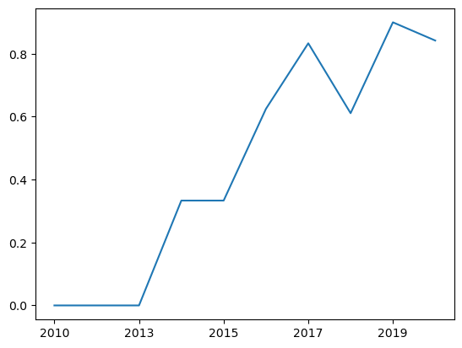
EDA with Data Visualization
To explore data, scatter plots, line charts and barplots were used to visualize the relationship between pair of features:
Flight Number & Payload
Flight Number & Launch Site
Payload & Launch Site
Success rate & Orbit Type
Flight number & Orbit type
Payload & Orbit Type
The Launch success over the years
GitHub URL: https://github.com/malinaghenu/Coursera/blob/4c91970d80d4e4f0bf2fb3ac54d623d3bbabc278/5.%20jupyter-labs-eda-dataviz.ipynb

Slide 13
EDA with SQL
The following SQL queries were performed:
Displayed the names of the unique launch sites
Top 5 records where launch sites begin with the string 'CCA'
Displayed the total payload mass carried by boosters launched by NASA (CRS)
Displayed average payload mass carried by booster version F9 v1.1
Date when the first succesful landing outcome in ground pad was acheived.
List of the successful booster names in drone ship that have payload mass between 4000 and 6000
List of successful and failed mission outcomes
List of boosters which have carried the maximum payload mass
Months in 2015 of failure landing outcomes in drone ship, booster versions and launch site
Rank of the count of successful landing outcomes between the date 04-06-2010 and 20-03-2017.
GitHub URL: https://github.com/malinaghenu/Coursera/blob/4c91970d80d4e4f0bf2fb3ac54d623d3bbabc278/4.%20jupyter-labs-eda-sql-coursera_sqllite.ipynb

Slide 14
Build an Interactive Map with Folium
When building an interactive map with Folium, I used markers, circles, lines and marker clusters.
Markers indicate points like launch sites
Circles indicate highlighted areas around specific coordinates, like NASA Johnson Space Center
Marker Clusters indicate groups of events in each coordinate
Lines are used to indicate distance
GitHub URL: https://github.com/malinaghenu/Coursera/blob/4c91970d80d4e4f0bf2fb3ac54d623d3bbabc278/6.%20lab_jupyter_launch_site_location%20(2).ipynb

Slide 15
Build a Dashboard with Plotly Dash
The following plots and graphs were used to visualize data:
Percentage of launches by site
Payload range
This combination allowed to quickly analyze the relationship between payloads and launch sited, helping to identify the best place to successfully launch.
GitHub URL: https://github.com/malinaghenu/Coursera/blob/4c91970d80d4e4f0bf2fb3ac54d623d3bbabc278/7.%20spacex_dash_app.py

Slide 16
Predictive Analysis (Classification)
Four classification models were compared:
Logistic Regression
Support Vector Machine (SVM)
Decision tree
K-nearest Neighbour
GitHub URL: https://github.com/malinaghenu/Coursera/blob/5c6411522ccbb8e7807e062a2f16001fd52f9295/8.%20SpaceX_Machine%20Learning%20Prediction_Part_5%20(1).ipynb
Data preparation and standardization
Test of each model with combinations of hyperparameters
Comparison of results

Slide 17
Results
Exploratory data analysis results
SpaceX uses four different launch sites. In the maps created we can observe all of them being near the Ocean. We calculated and displayed:
distance to coastline,
distance to railways,
distance to highways and
distance to nearest towns.
The first successful landing was in 2015, five years after first launch
Almost 100% of mission outcomes were successful & two booster versions failed at landing
The number of successful outcomes continually improved

Slide 18
Insights drawn from EDA
Section 2

Slide 19
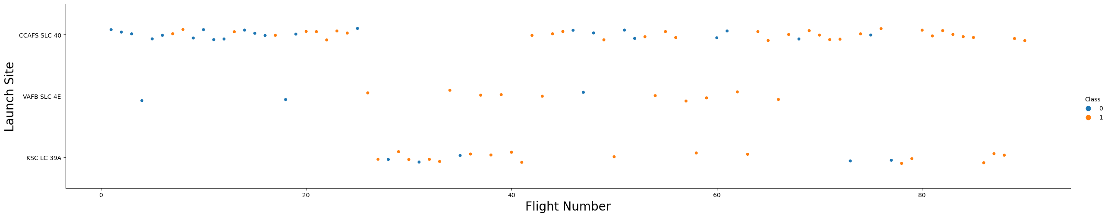
Flight Number vs. Launch Site
According to the scatter plot above, the most successful launch site is CCAFS SLC 40
We can also observe that the success rate has improved over time

Slide 20
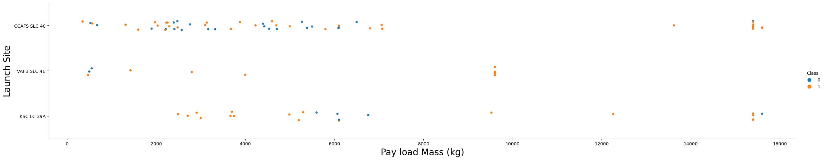
Payload vs. Launch Site
In the scatter plot above we can see that higher payloads have better success rate.
The success rate of payload mass above 8000kg is almost 100%.
At the VAFB-SLC launchsite there were no rockets launched with a mass greater that 10 000kg.

Slide 21
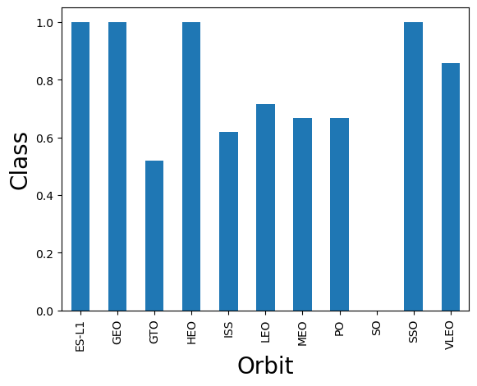
Success Rate vs. Orbit Type
The best success rate is for orbits ES-L1, GEO, HEO and SSO.
For orbit SO there was no successful landing.

Slide 22
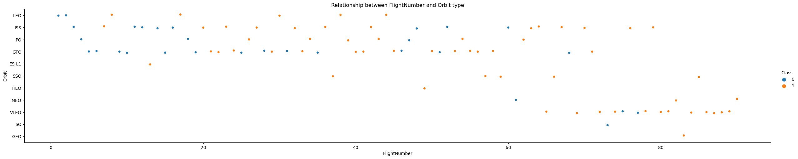
Flight Number vs. Orbit Type
In the LEO orbit the Success appears related to the number of flights; on the other hand, there seems to be no relationship between flight number when in GTO orbit

Slide 23
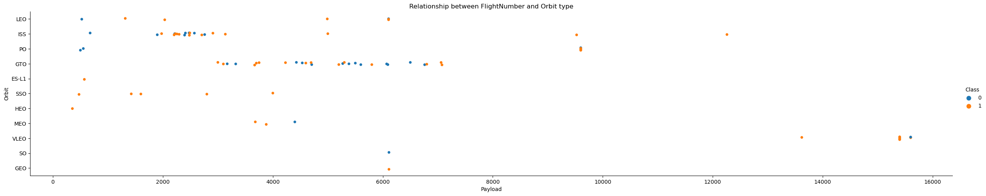
Payload vs. Orbit Type
With heavy payloads the successful landing or positive landing rate are more for Polar,LEO and ISS.
However for GTO we cannot distinguish this well as both positive landing rate and negative landing(unsuccessful mission) are both there here.

Slide 24
Launch Success Yearly Trend
From the plot, we can oserve that the success rate continually increased since 2013.

Slide 25
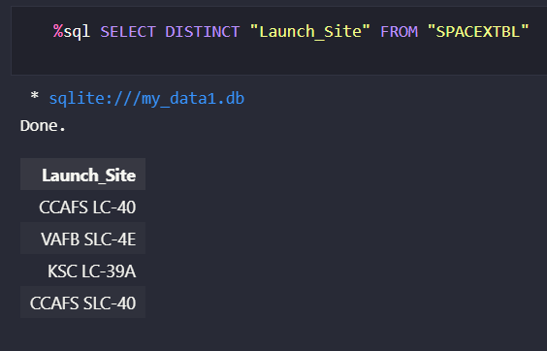
All Launch Site Names
I used the KeyWord DISTINCT, to only show the unique SpaceX Launch Sites.

Slide 26
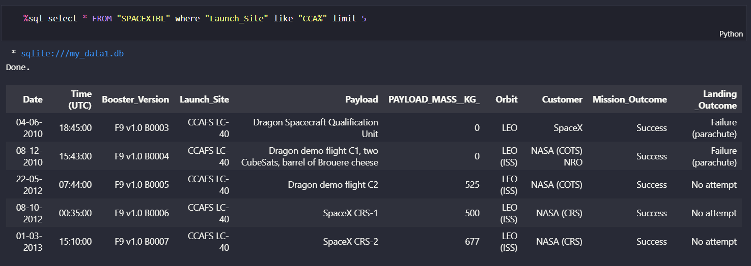
Launch Site Names Begin with 'CCA'
Find 5 records where launch sites begin with `CCA

Slide 27
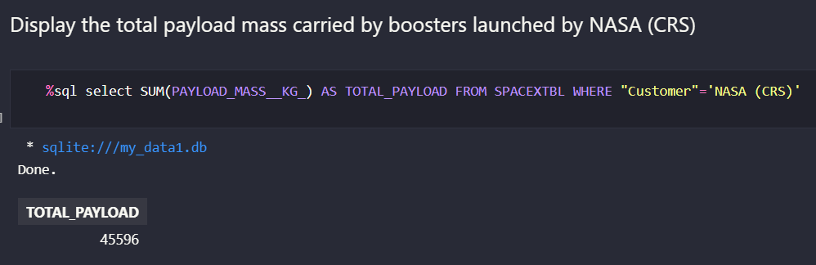
Total Payload Mass
The total payload carried by boosters from NASA is 45596.

Slide 28
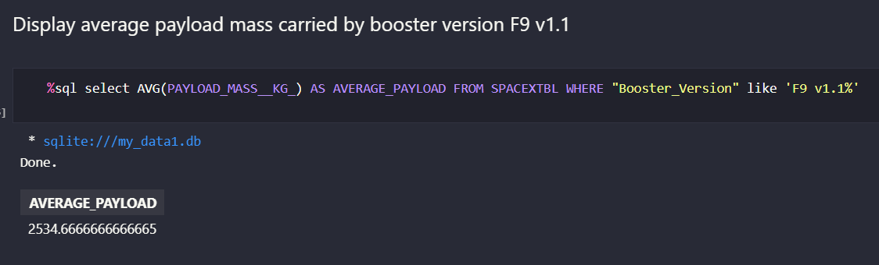
Average Payload Mass by F9 v1.1
The average payload mass carried by booster version F9 v1.1 is 2534.6

Slide 29
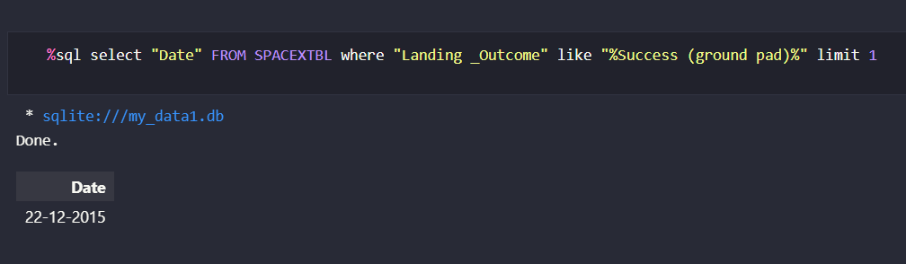
First Successful Ground Landing Date
The date of the first successful landing outcome on ground pad was 22-12-2015

Slide 30
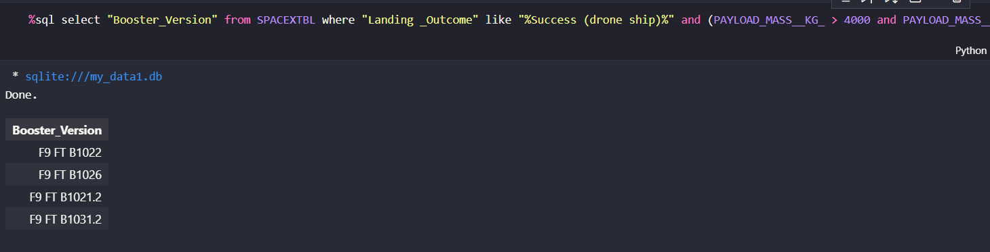
Successful Drone Ship Landing with Payload between 4000 and 6000
List of the names of boosters which have successfully landed on drone ship and had payload mass greater than 4000 but less than 6000. Full code:
%sql select "Booster_Version" from SPACEXTBL where "Landing _Outcome" like "%Success (drone ship)%" and (PAYLOAD_MASS__KG_ > 4000 and PAYLOAD_MASS__KG_ < 6000)

Slide 31
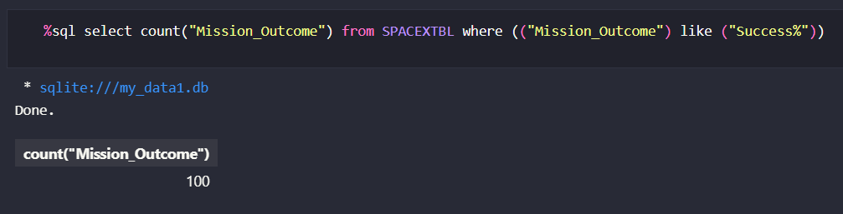
Total Number of Successful and Failure Mission Outcomes
There was a total of 100 successful mission outcomes and only one failure.

Slide 32
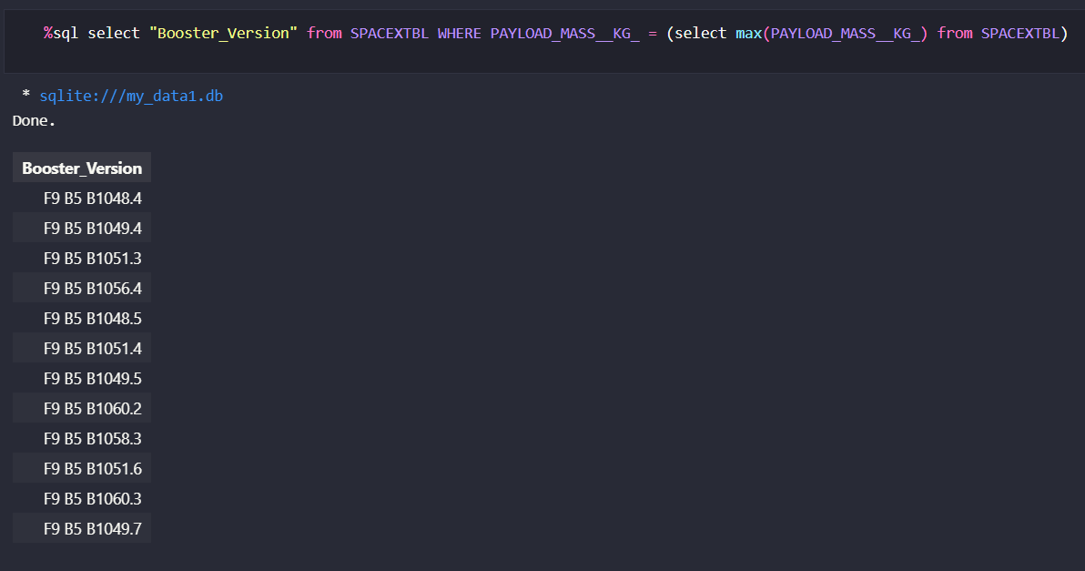
Boosters Carried Maximum Payload
We determined the list of the names of the booster which have carried the maximum payload mass using a subquery and the MAX() function.

Slide 33
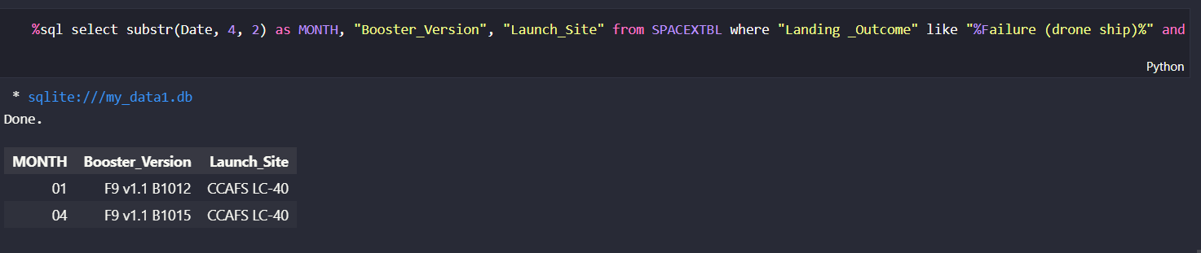
2015 Launch Records
I determined the list of failed landing outcomes in drone ship, their booster versions, and launch site names for in year 2015, using the WHERE clause, LIKE, AND and BETWEEN conditions, to filter the results. Full code is:
%sql select substr(Date, 4, 2) as MONTH, "Booster_Version", "Launch_Site" from SPACEXTBL where "Landing _Outcome" like "%Failure (drone ship)%" and substr(Date,7,4)='2015'

Slide 34
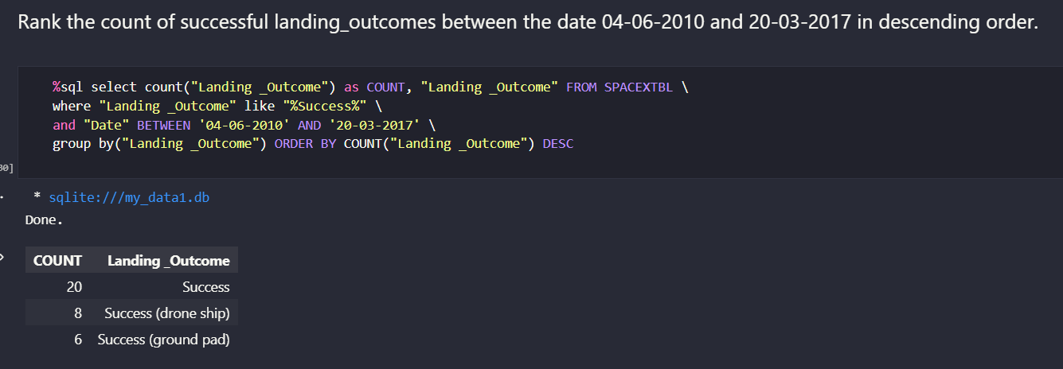
Rank Successful Landing Outcomes Between 2010-06-04 and 2017-03-20
I ranked the count of successful landing outcomes between the date 2010-06-04 and 2017-03-20, in descending order, by creating a new column named "COUNT" that used the function count from Landing_Outcome column. Then, I filtered the results to show only the successful outcome between the desired dates, grouped the outcomes and sorted them in descending order.
*task asked for successful landing outcomes

Slide 35
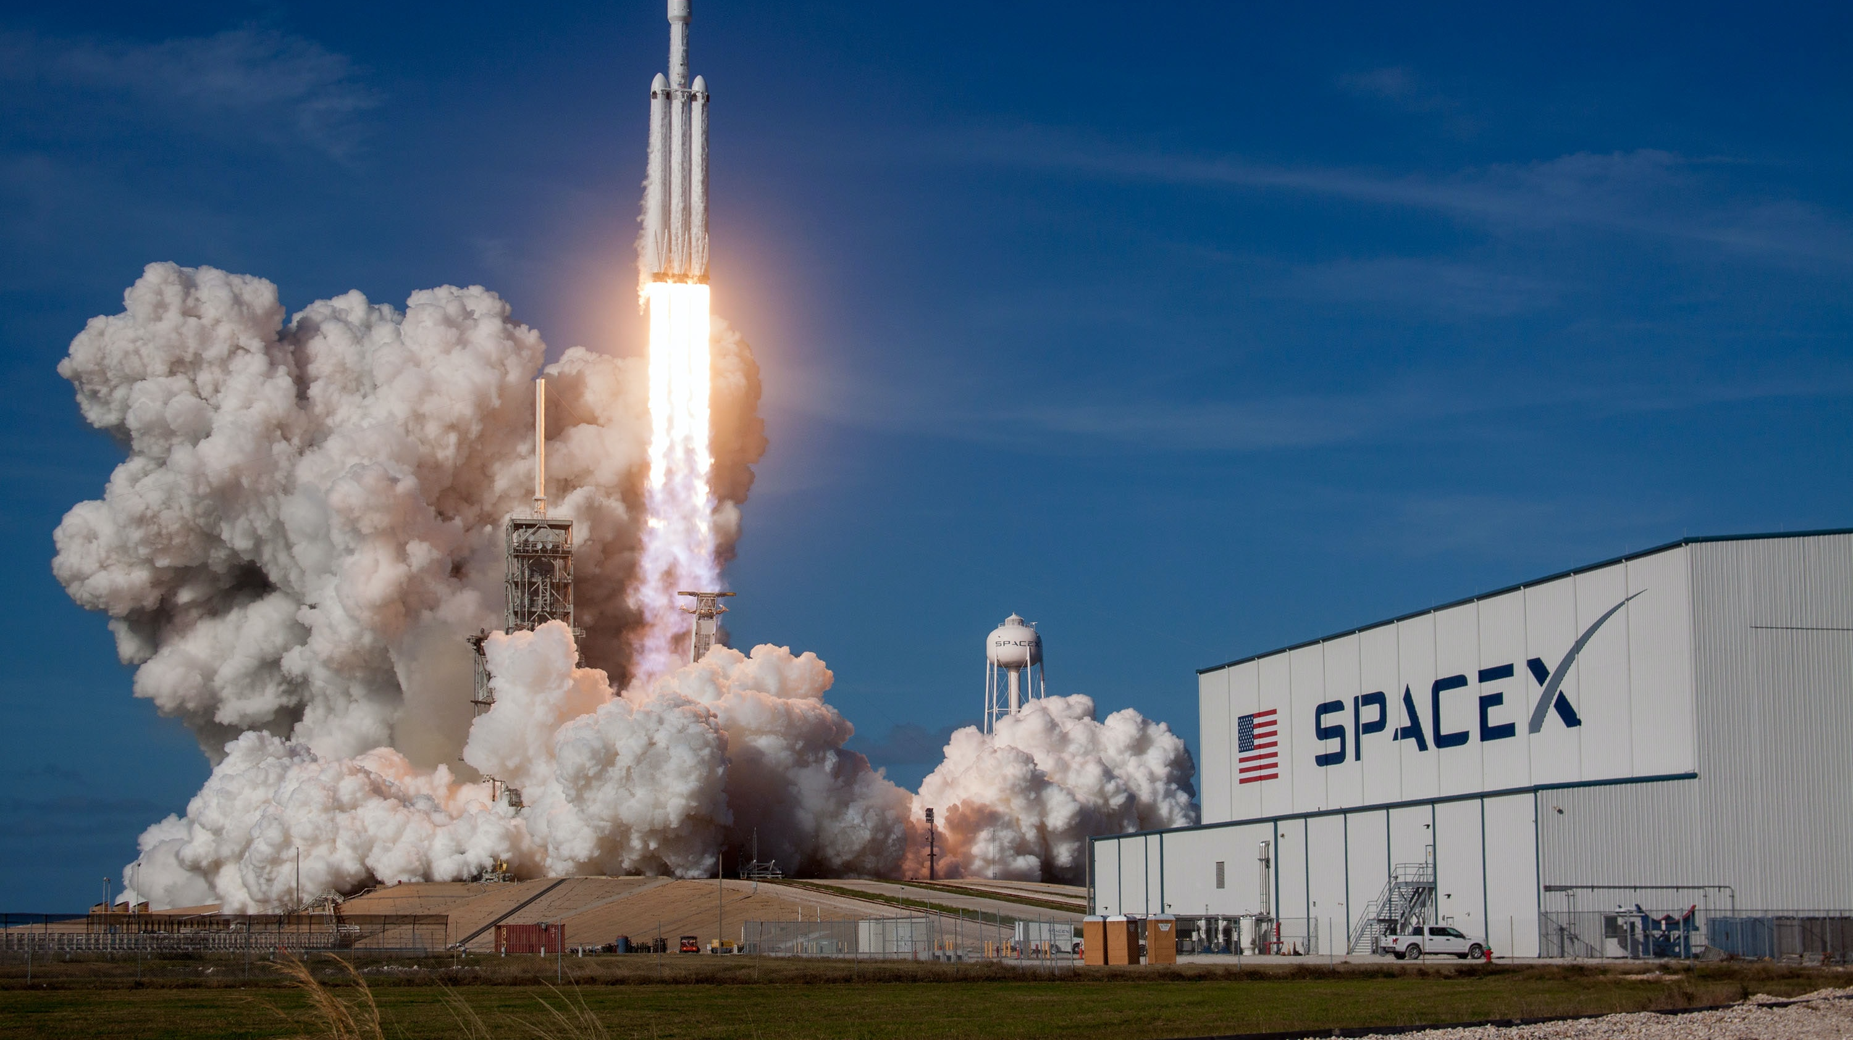
Launch Sites Proximities Analysis
Section 3

Slide 36
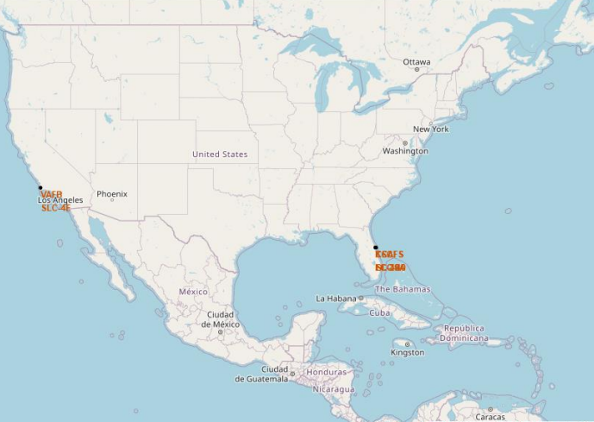
Launch Sites
We can see that all Launching Sites are in the USA, on the coast.

Slide 37
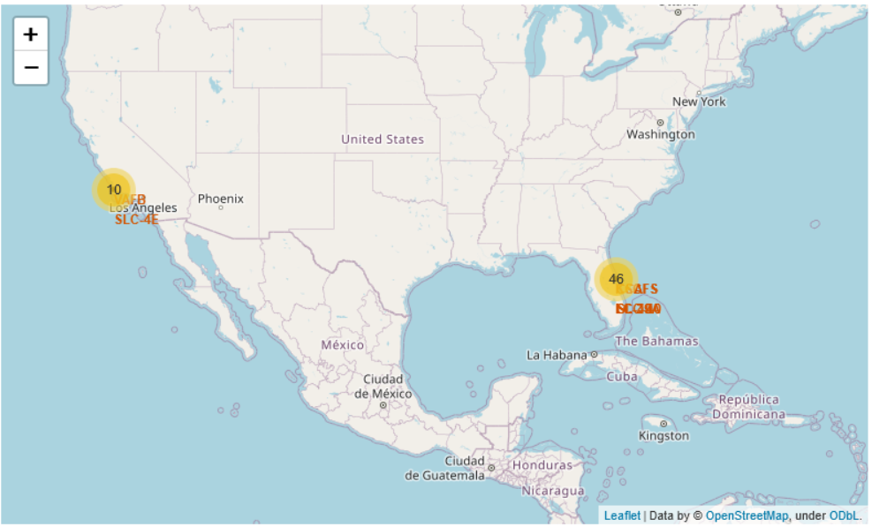
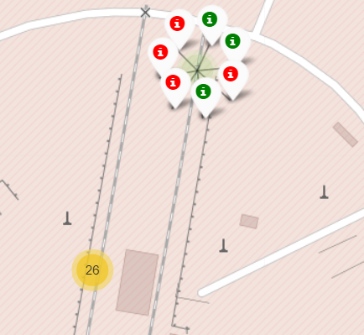
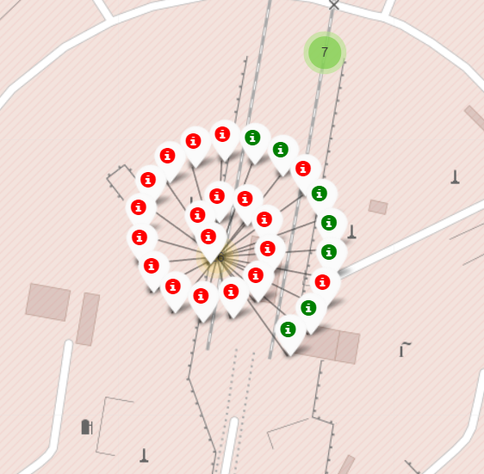
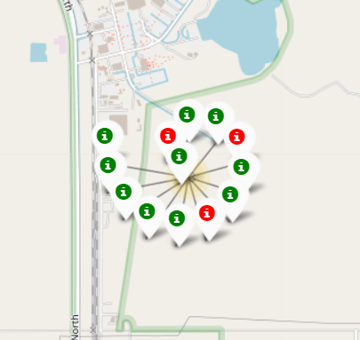
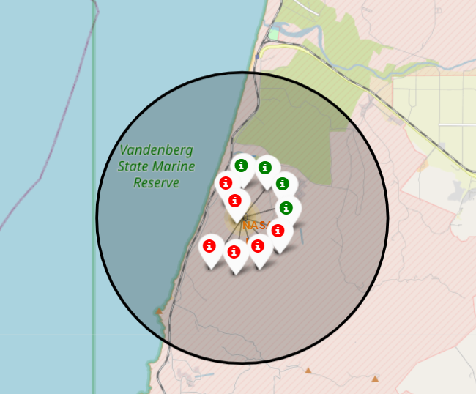
SUCCESS/FAILED LAUNCHES FOR EACH SITE
CCAFS SLC-40
CCAFS LC-40
Launches have been grouped into clusters and annotated with green markers for successful landings and red markers for unsuccessful.
VAFB SLC-4E
KSC LC-39A

Slide 38
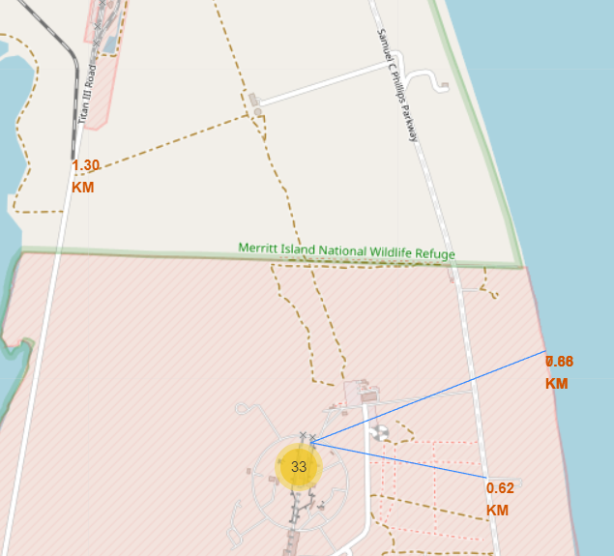
PROXIMITY OF LAUNCH SITES TO OTHER POINTS OF INTEREST
Using the CCAFS SLC-40 launch site as an example site, we can understand more about the placement of launch sites.
On the we can see that the CCAFS SLC-40 distance to coastline is 0.66 km, to highway 0,62km and to the closest railway, 1,30km.
By creating interactive maps, we found out that Launch sites are near coastline, highway and railway but keep a certain distance from the cities.
The CCAFS distance to Cape Canaveral is 18.2 km.

Slide 39
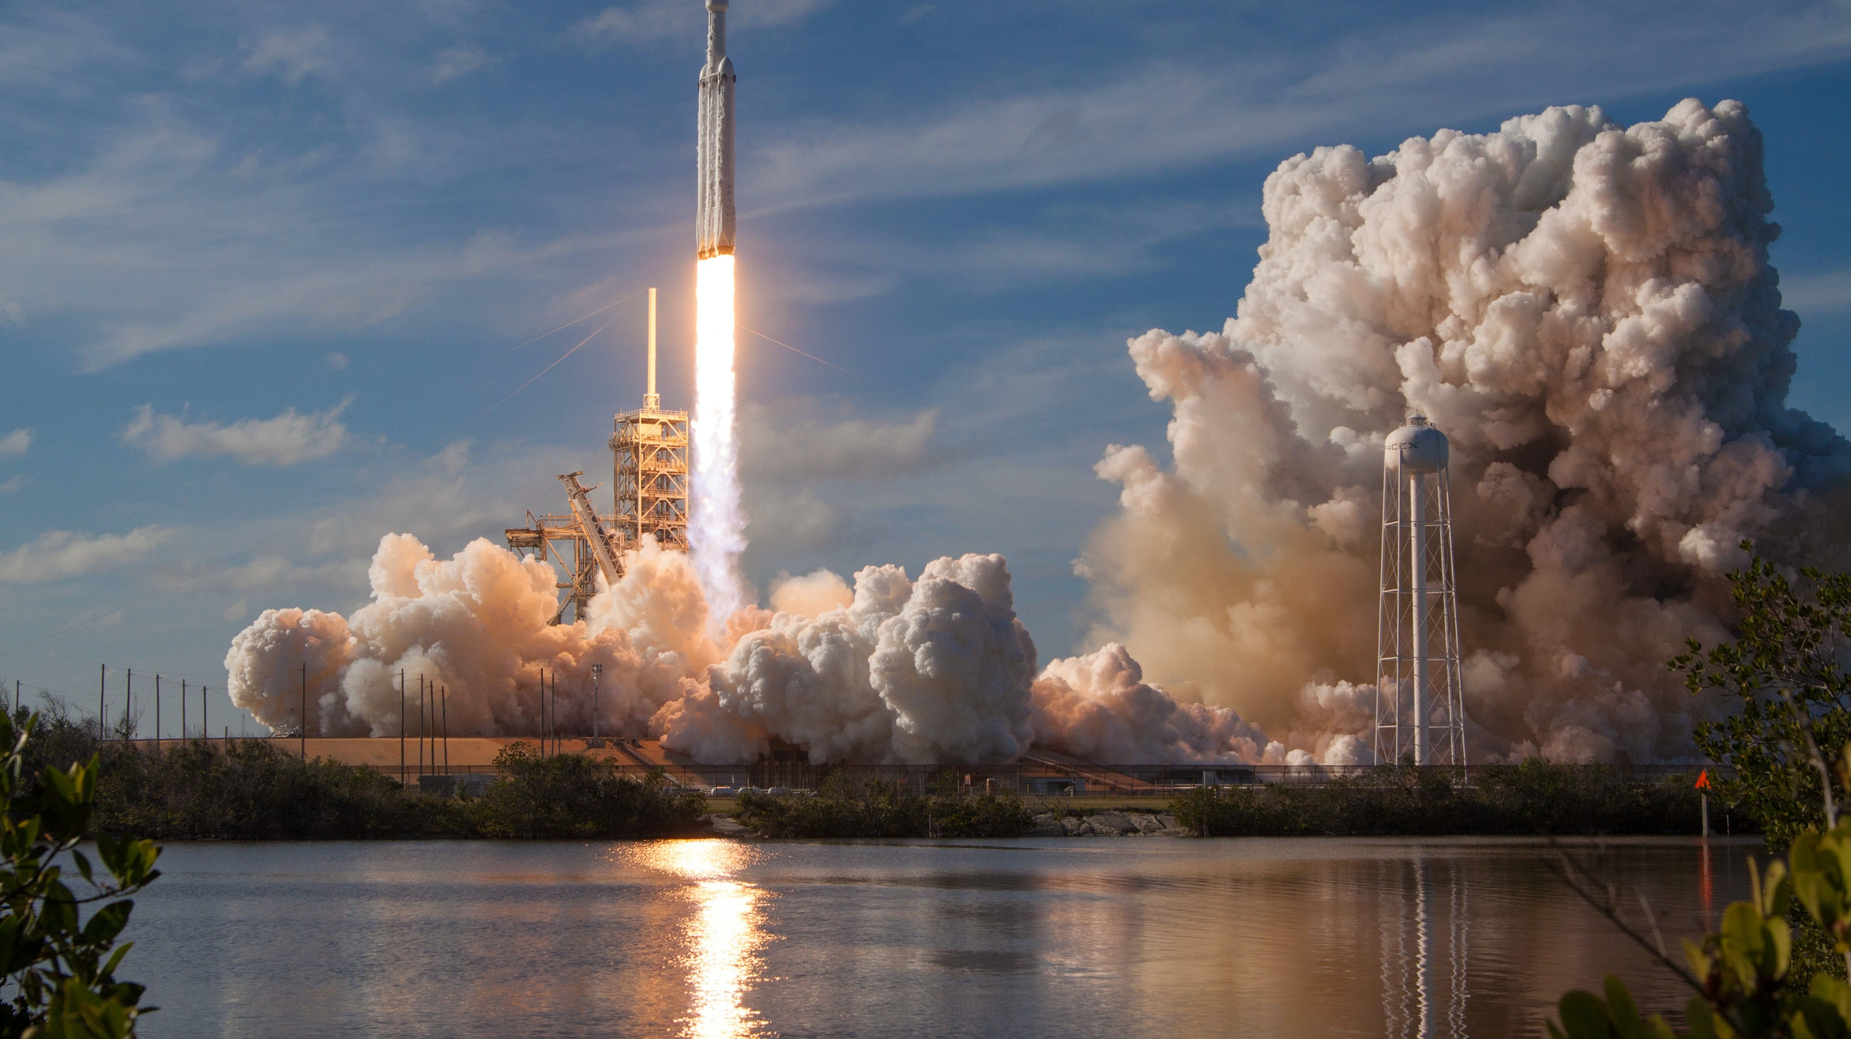
Build a Dashboard with Plotly Dash
Section 4

Slide 40
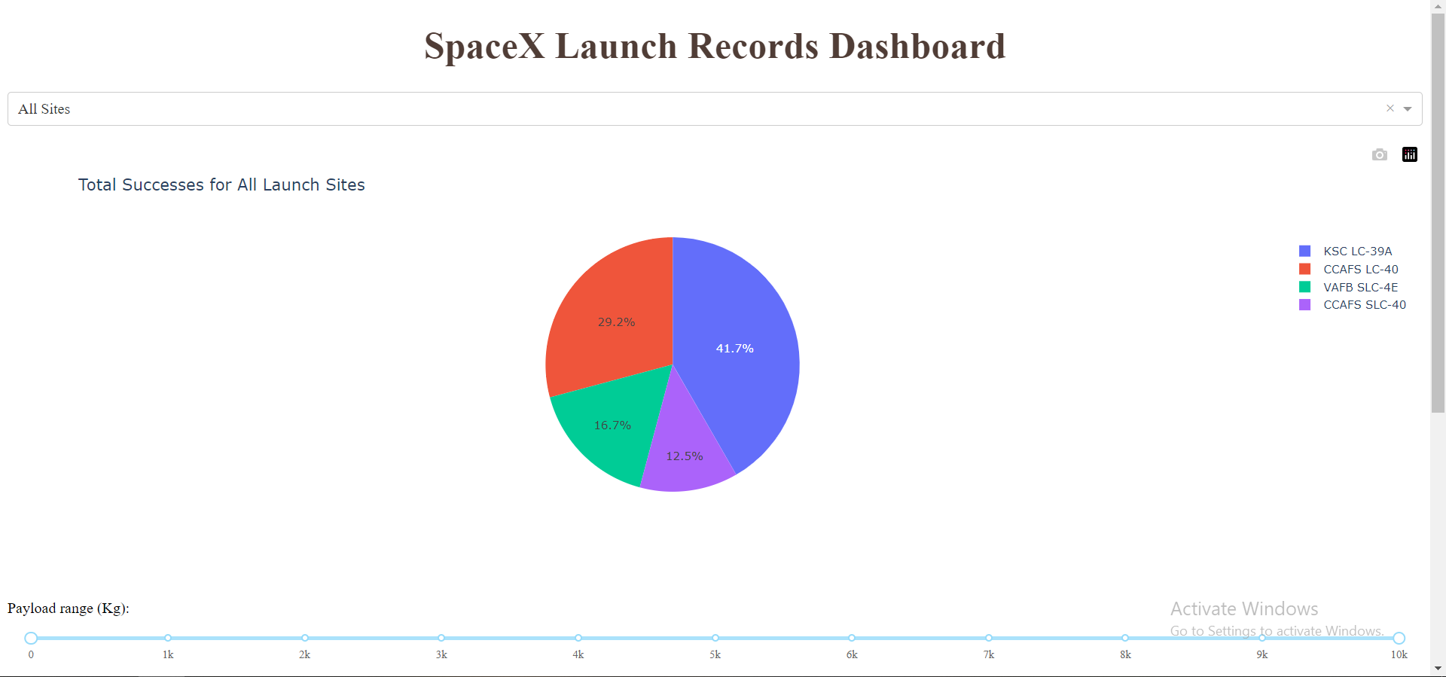
LAUNCH SUCCESS COUNT FOR ALL SITES
The launch site KSC LC-39 A had the most successful launches, with 41.7% of the total successful launches.

Slide 41
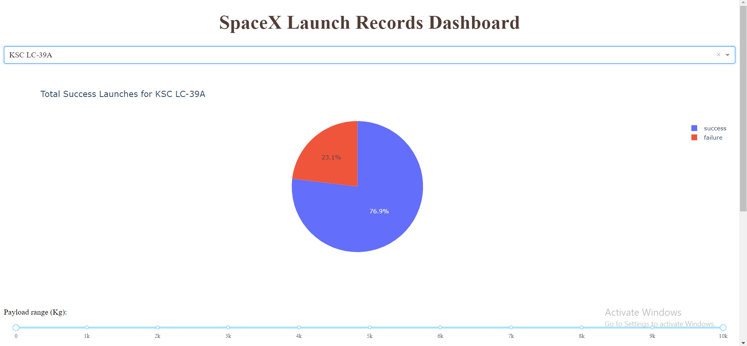
PIE CHART FOR THE LAUNCH SITE WITH HIGHEST LAUNCH SUCCESS RATIO
The launch site KSC LC-39 A also had the highest rate of successful launches, with a 76.9% success rate.

Slide 42
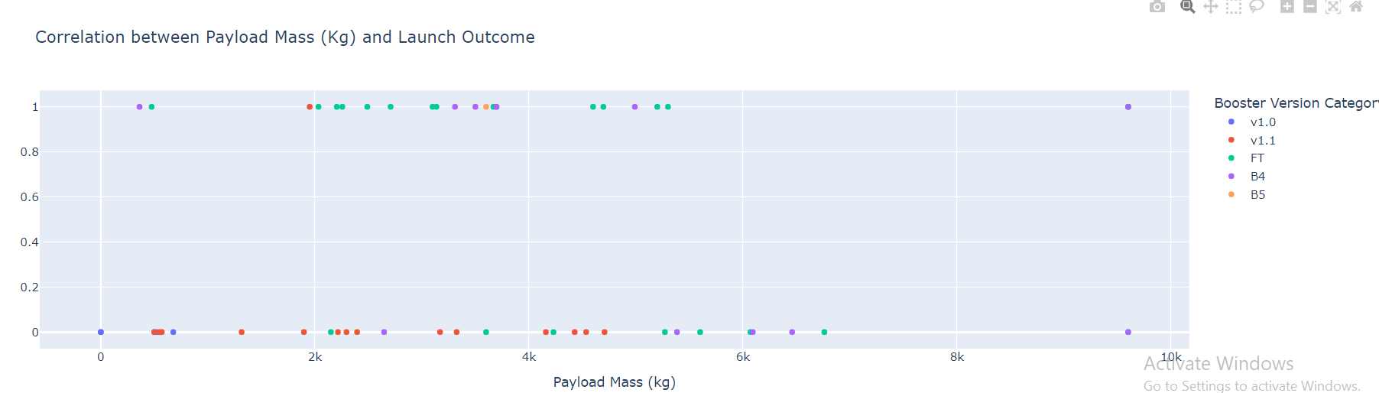
LAUNCH OUTCOME VS. PAYLOAD SCATTER PLOT FOR ALL SITES
Low payloads
Massive payloads
Plotting the launch outcome vs. payload for all sites shows a gap around 4000 kg, so it makes sense to split the data into 2 ranges:
0 – 4000 kg (low payloads)
4000 – 10000 kg (massive payloads)
From these 2 plots, it can be shown that the success for massive payloads is lower than that for low payloads.
It is also worth noting that some booster types (v1.0 and B5) have not been launched with massive payloads.

Slide 43
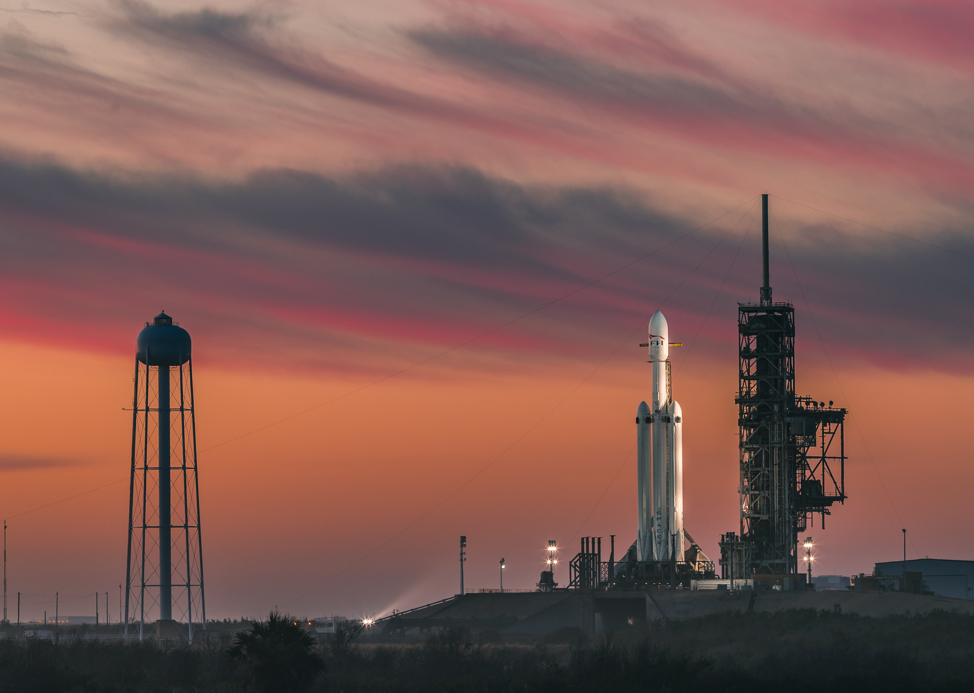
Predictive Analysis (Classification)
Section 5

Slide 44
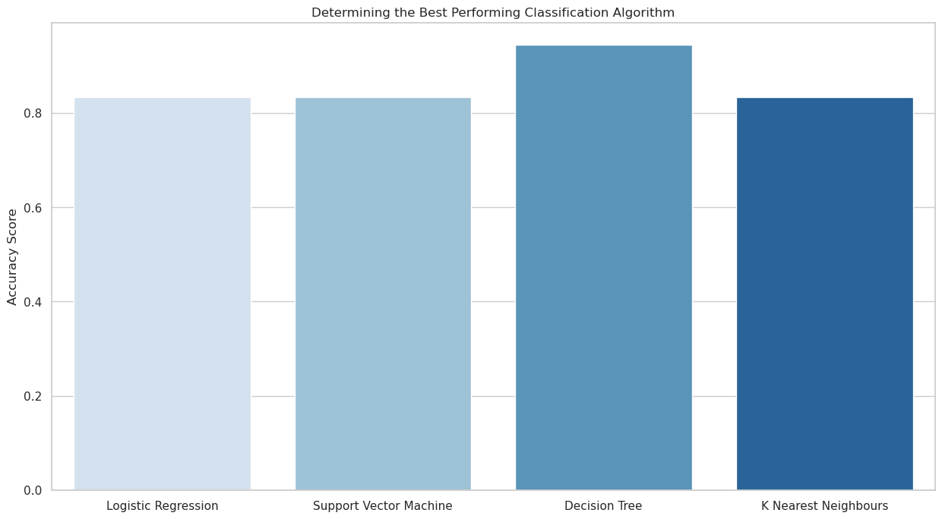
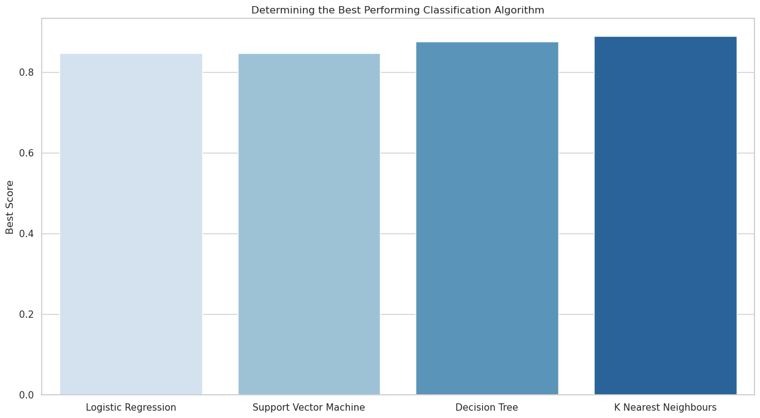
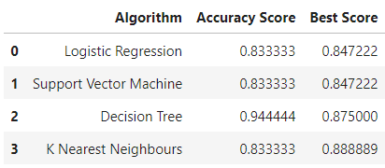
Classification Accuracy
Plotting the Accuracy Score and Best Score for each classification algorithm produces the following result:
The Decision Tree model has the highest classification accuracy
The Accuracy Score is 94.44%
The Best Score is 90.36%

Slide 45
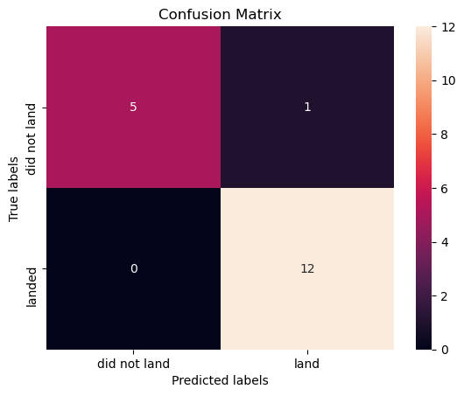
Confusion Matrix
As shown previously, best performing classification model is the Decision Tree model, with an accuracy of 94.44%.
This is explained by the confusion matrix, which shows only 1 out of 18 total results classified incorrectly (a false positive, shown in the top-right corner).
The other 17 results are correctly classified (5 did not land, 12 did land).

Slide 46
Conclusions
As the number of flights increases, the rate of success at a launch site increases, with most early flights being unsuccessful. I.e. with more experience, the success rate increases.
Between 2010 and 2013, all landings were unsuccessful (as the success rate is 0).
After 2013, the success rate generally increased, despite small dips in 2018 and 2020.
After 2016, there was always a greater than 50% chance of success

Slide 47
Conclusions
Orbit types ES-L1, GEO, HEO, and SSO, have the highest (100%) success rate.
The 100% success rate of GEO, HEO, and ES-L1 orbits can be explained by only having 1 flight into the respective orbits.
The 100% success rate in SSO is more impressive, with 5 successful flights.
The orbit types PO, ISS, and LEO, have more success with heavy payloads:
VLEO (Very Low Earth Orbit) launches are associated with heavier payloads, which makes intuitive sense.

Slide 48
The launch site KSC LC-39 A had the most successful launches, with 41.7% of the total successful launches, and also the highest rate of successful launches, with a 76.9% success rate.
The success for massive payloads (over 4000kg) is lower than that for low payloads.
The best performing classification model is the Decision Tree model, with an accuracy of 94.44%.
Conclusions

Slide 49
Appendix
Folium didn’t show maps on Github, so I took screenshots.

Slide 50
Thank you!

